Slide 1
Undergrads and Internships
509-335-6000
ASCC@wsu.edu
www.ASCC.wsu.edu

Slide 2
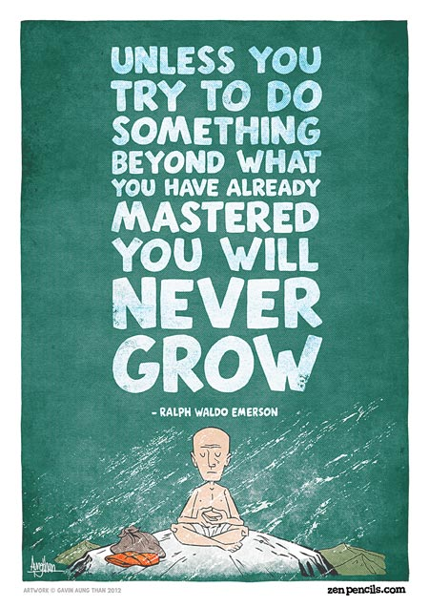
A moment to share
Has a student ever informed you that they were completing their degree for reasons entirely other than helping them get a job later on?

Slide 3
Agenda
Career Development Themes by Year
Preliminary Concerns
Opportunities & the Data
CougLink
ASCC Career Events
One-On-One Assistance
Resume Coloring Book

Slide 4
The Purpose of Career Development
Your Workshop Objectives

Slide 5
Career Development Themes
Your Workshop Objectives
Year Theme
1st Year | Discover
2nd Year | Explore
3rd Year | Commit
4th Year and Beyond | Search
Notes:
At the ASCC, we like to help students think big picture, and assess where they are in their career development each year.
Discover – not expected to have major a major, 100+ options, normal to discover to investigate major opportunities
Explore – narrow options down to 2 or 3, gather information in more detail, visit with departments and talk with major advisors
Commit – select one major and continue to meet certification requirements, develop plan for internship
Search – job search, 1 year, based on relationships, that’s why it takes a year

Slide 6
Career Development Themes
Your Workshop Objectives
Career worries & desires
Good pay
Foundation for successful internship search
Clearer goals
Is it competitive?
Will my major help me?
Polished resume
LinkedIn/networking strategy
Career Development
Interview preperation
Establishing meaning
Acknowledging challenges
Normalizing the process
Creating a plan
How can I get credentials?
Will I enjoy my job?
Notes:
Students are often feel acutely aware of reasons why they aren’t set up for success, but that inclination by itself doesn’t mean they are going to become prepared. As an advisor you have access to these students several times a year and could be assessing their level of readiness and encouraging them to take constructive actions.

Slide 7
Why Emphasize Internships?
Your Workshop Objectives
96.9 % of responding employers plan to hire interns and/or co-op students in 2014.
Recruiting new hires is the primary focus of internship programs by 77.6 % of employers and co-op programs by
62.6 % of employers.
Employers made full-time offers to 64.8 % of their interns; 56.8 % of their co-op students.
79 % of interns accepted a full-time job offer with their internship employer; 82.2 % of co-op students accepted a full-time job offer.
Source: 2014 Internship & Co-op Survey, National Association of Colleges and Employers
Notes:
Why emphasize internships? To put it simply the data suggests that employers desire their candidates that have completed internships. The undergraduate degree with no other qualifications or experiences poorly prepares a student for the job market.

Slide 8
Why do employers want interns?
Your Workshop Objectives
Retention
Lower Risk
Lower Cost
Employers reported that 97.5 % of their internships would be paid in 2014.
The average hourly wage for interns at the bachelor’s degree level is $16.35.
After one year, employers retain about three-quarters of their new college hires who have internship experience.
After one year, employers retain more than 50 % of new hires who completed a co-op program.
Source: 2014 Internship & Co-op Survey, National Association of Colleges and Employers

Slide 10
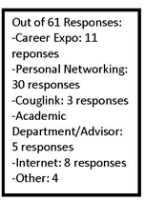

Slide 11
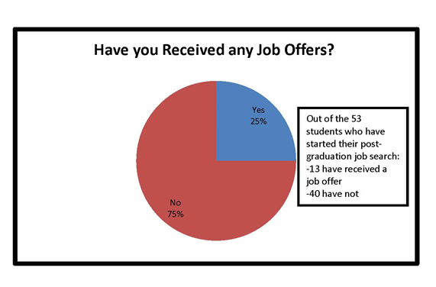

Slide 12
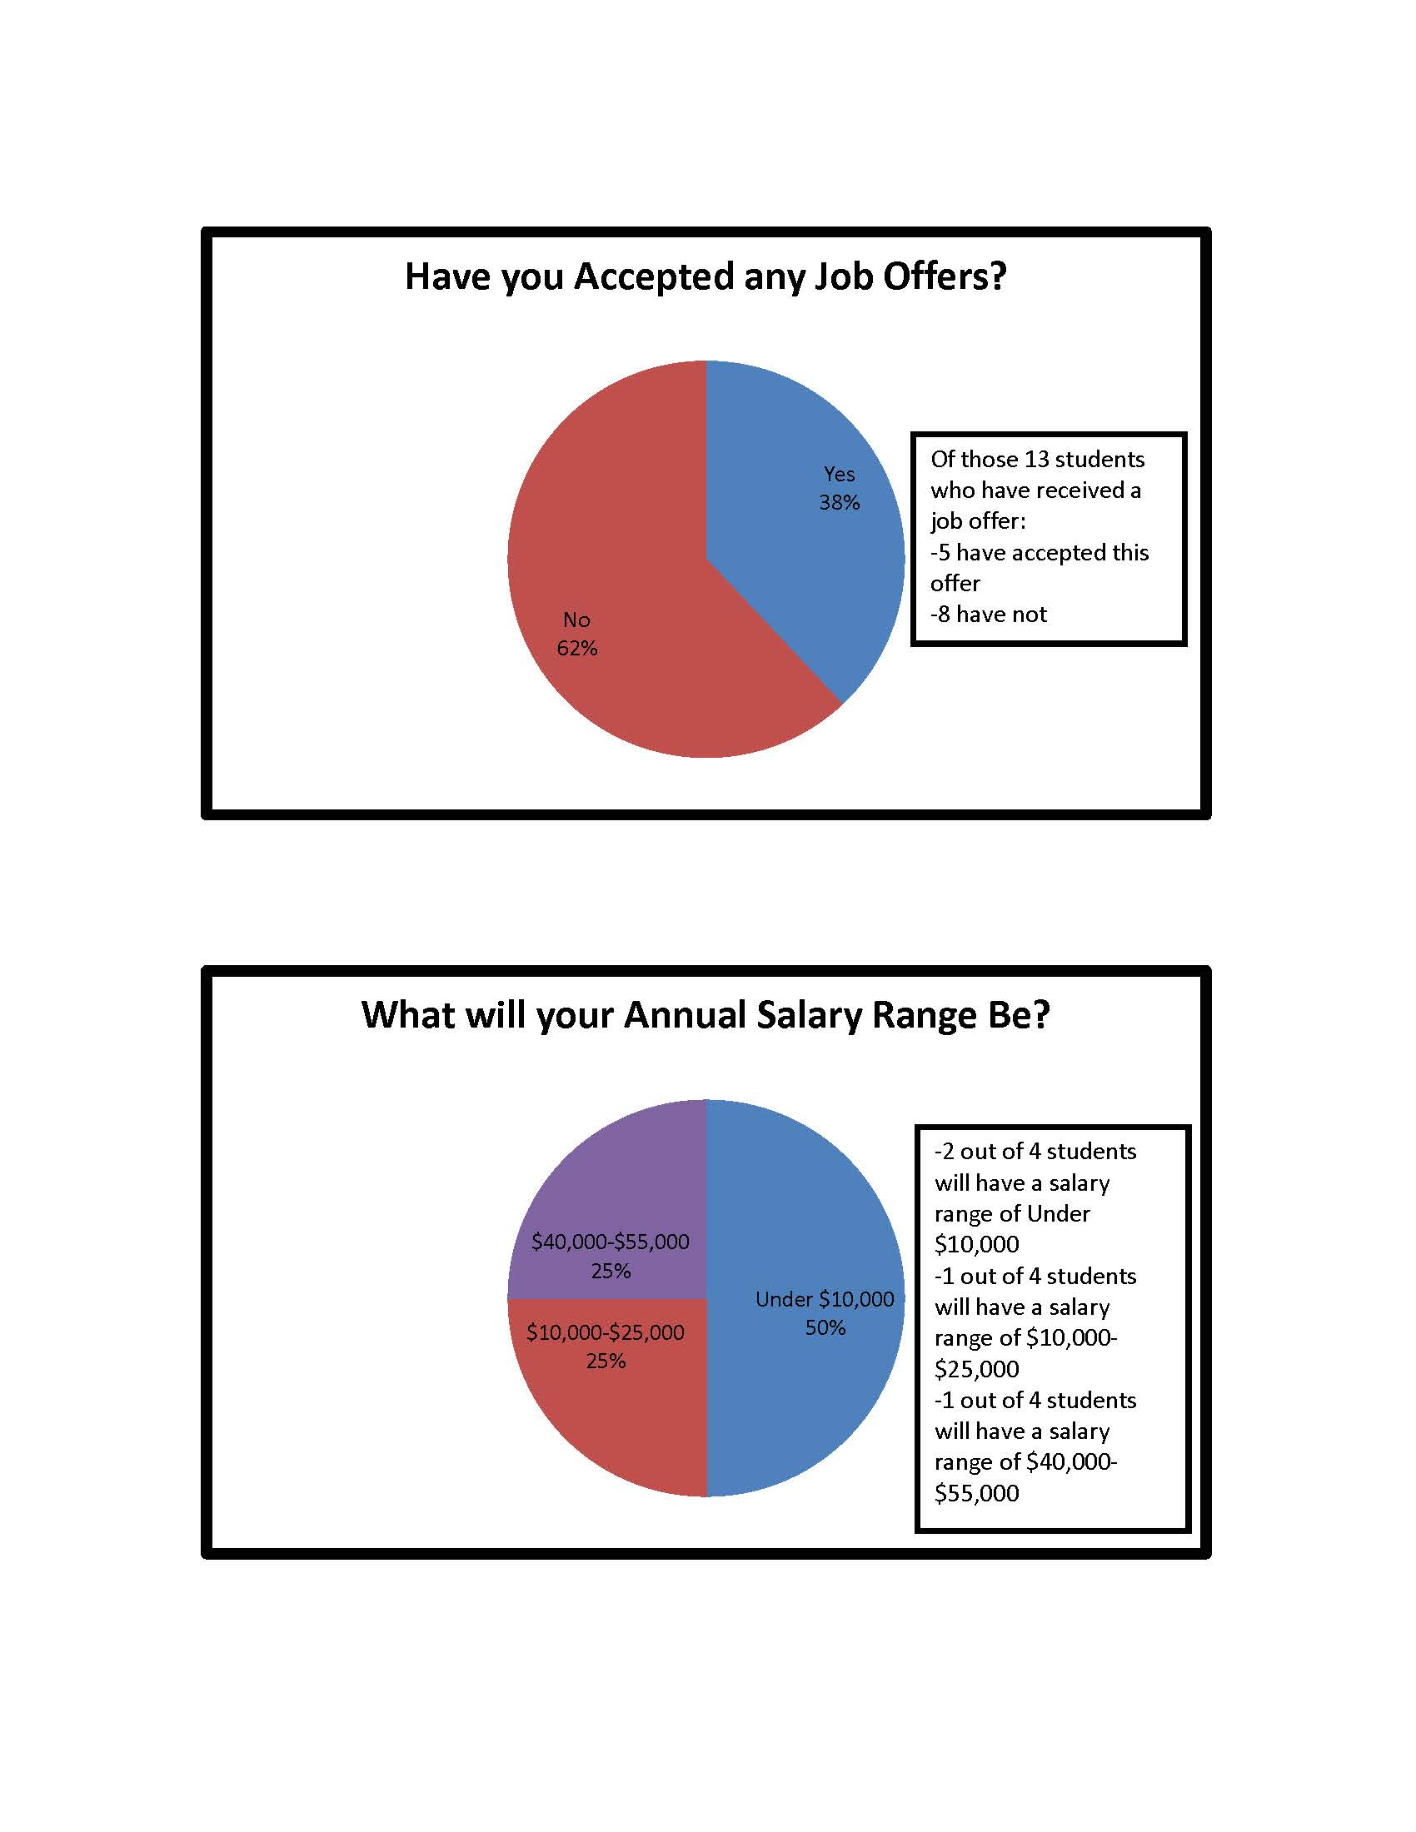

Slide 13
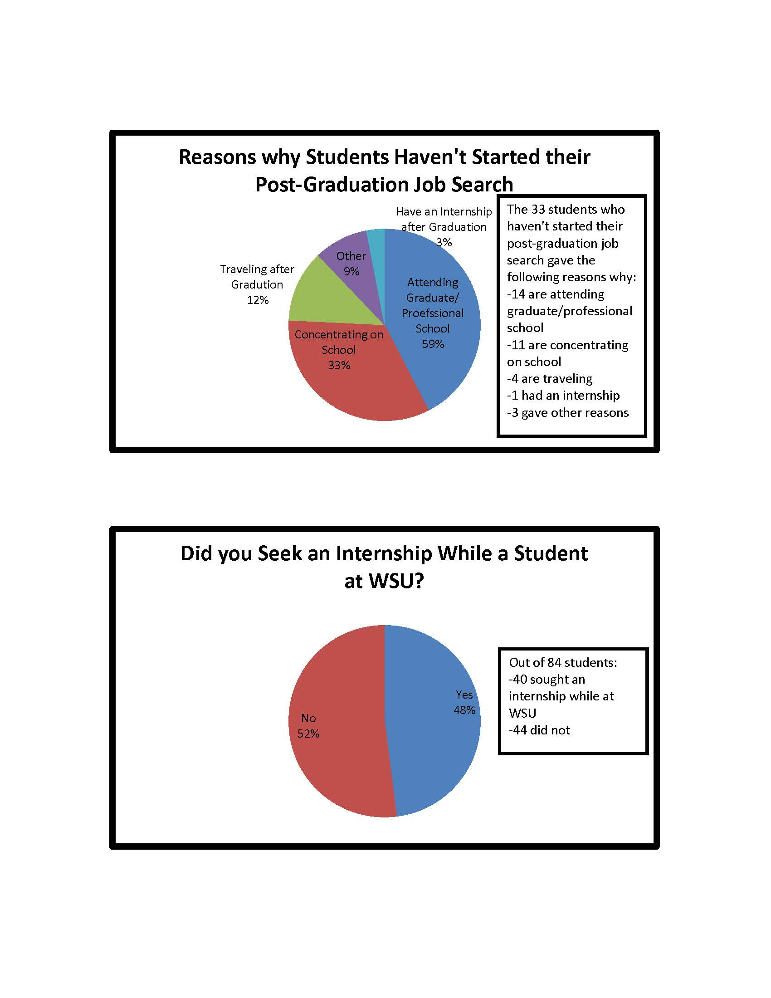

Slide 16
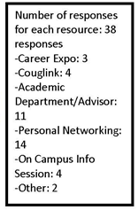

Slide 17
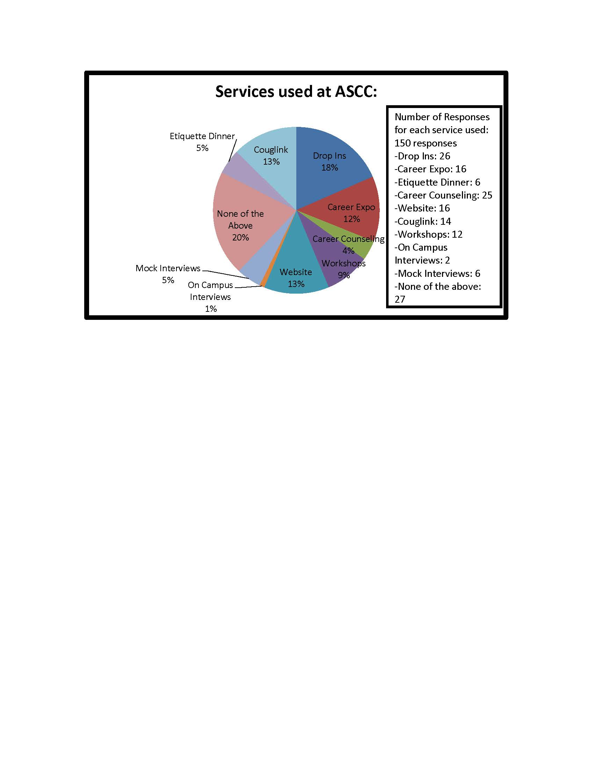

Slide 18
Why the discrepancy?
Knowledge of Self and Employer
NACE survey results show employers report they are highly likely to extend offers to their interns & that internships are a desirable qualification aside from their likelihood to hire their own interns.
Why then did so few of the students have an employment offer already if a significant portion of them completed an internship?
Notes:
Brainstorm time:
CAS students completed internships in settings that could not extend offers after graduation (what settings are those? Perhaps higher education, perhaps non-profit positions). Perhaps these students do not know how to capitalize on their experiences in ways that show their value to employers. Perhaps they did a bad job. Perhaps they are unlucky. Perhaps they are not searching effectively. Perhaps they learned they did not want to pursue a career related to their internship and now they are feeling lost.

Slide 19
Where is the opportunity?
Knowledge of Self and Employer
Recruiters prefer high-touch recruiting methods for intern/co-op recruiting.
Career fairs and on-campus recruiting comprise more than half of employers’ recruiting budgets for interns and co-op students.
Career fairs and on-campus recruiting are rated highest in effectiveness for recruiting interns and co-ops.
Employers choose schools for recruiting interns and co-ops based on academic majors offered, perceived quality of the programs, and past recruiting experience at the school.
Source: 2014 Internship & Co-op Survey, National Association of Colleges and Employers
Notes:
What this tells us is that business spend a lot of cash on the type of recruiting they value most. They are likely to try to maximize their dollars value by targeting majors that respond the strongest to these recruitment efforts. This can leave CAS out in the cold. Where less attendance results in less advertised opportunities which results in less attendance. Either party can reverse the cycle but students have the least to risk and the most to gain out of the two.

Slide 20
Career Expo Attendance ~1100
Spring 2015

Slide 21
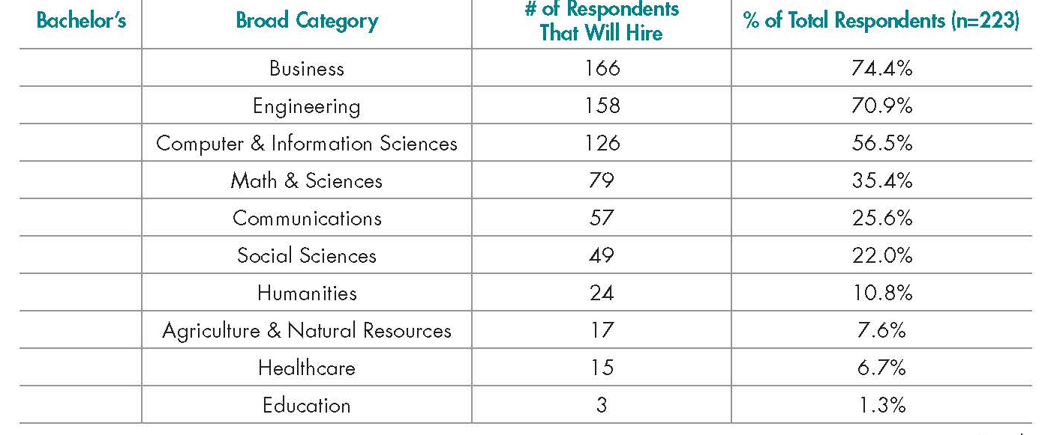
Are CAS jobs at the Career Expo?
Knowledge of Self and Employer
Survey respondents were asked to report on their hiring intentions for all broad categories of majors.
All Expo attendees are encouraged to research employers and open positions before attending the expo.
Source: 2015 Job Outlook, National Association of Colleges and Employers
Notes:
What this tells us is that business spend a lot of cash on the type of recruiting they value most. They are likely to try to maximize their dollars value by targeting majors that respond the strongest to these recruitment efforts. This can leave CAS out in the cold. Where less attendance results in less advertised opportunities which results in less attendance. Either party can reverse the cycle but students have the least to risk and the most to gain out of the two.

Slide 22
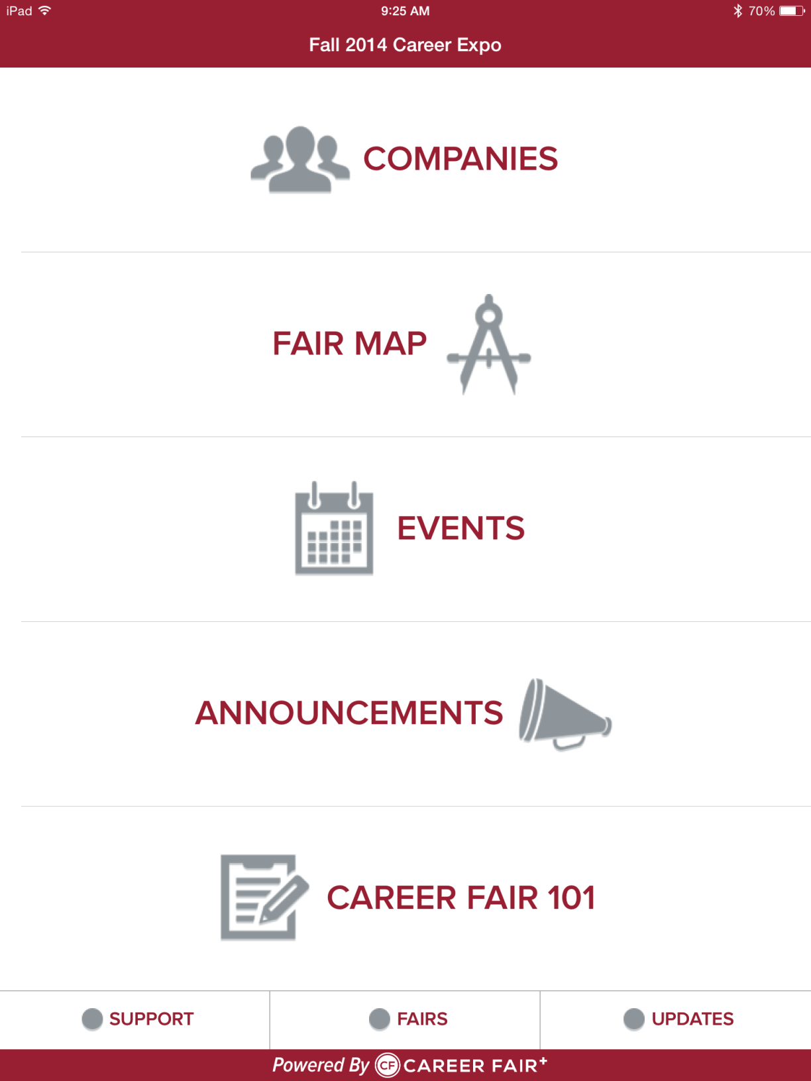
Knowledge of Self and Employer

Slide 23
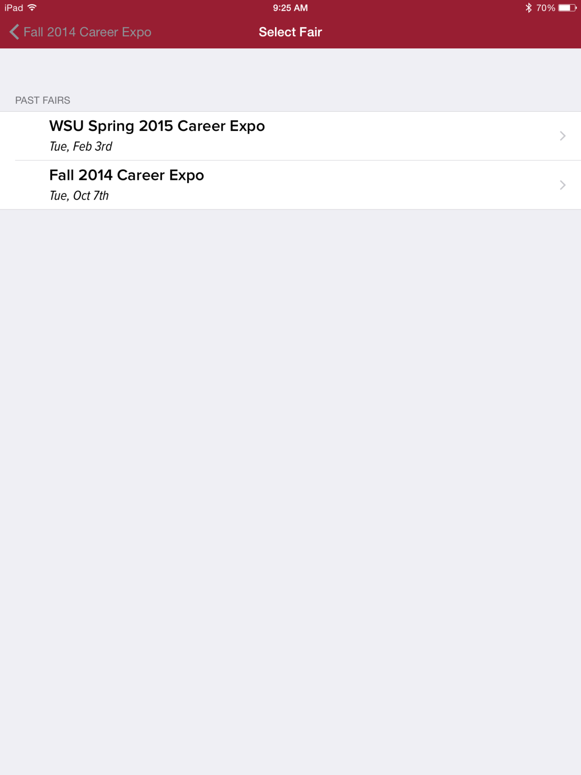
Knowledge of Self and Employer

Slide 24
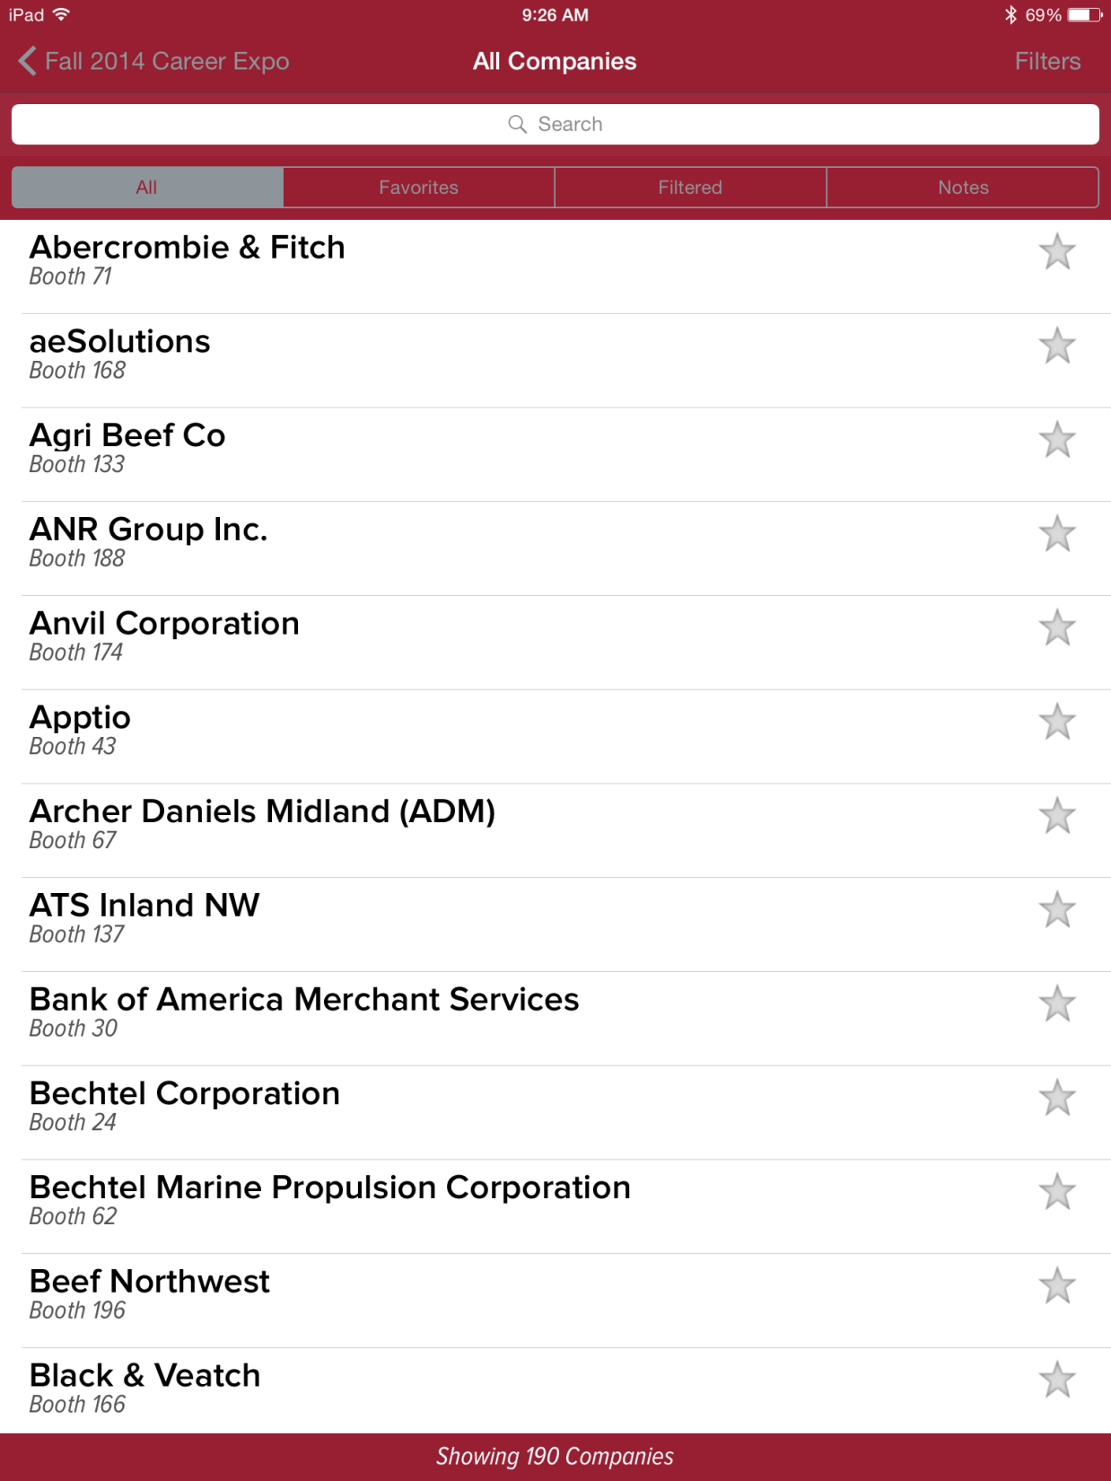
Knowledge of Self and Employer

Slide 25
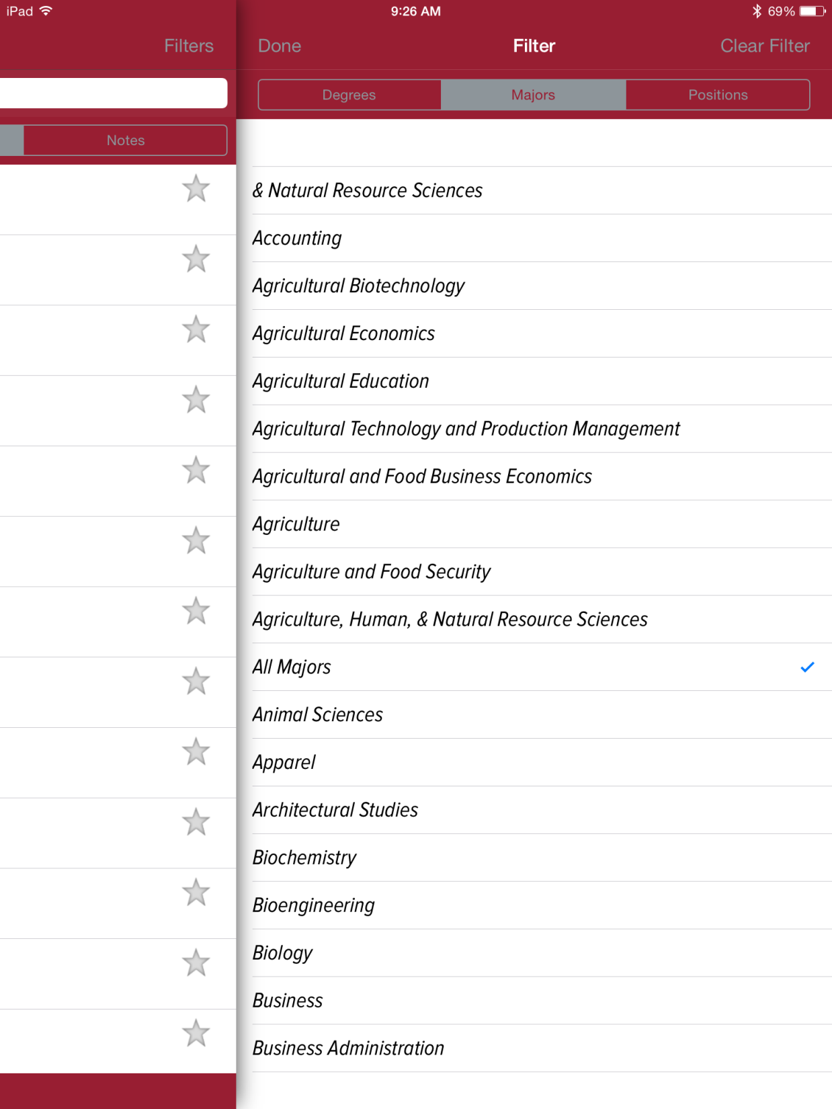
Knowledge of Self and Employer

Slide 26
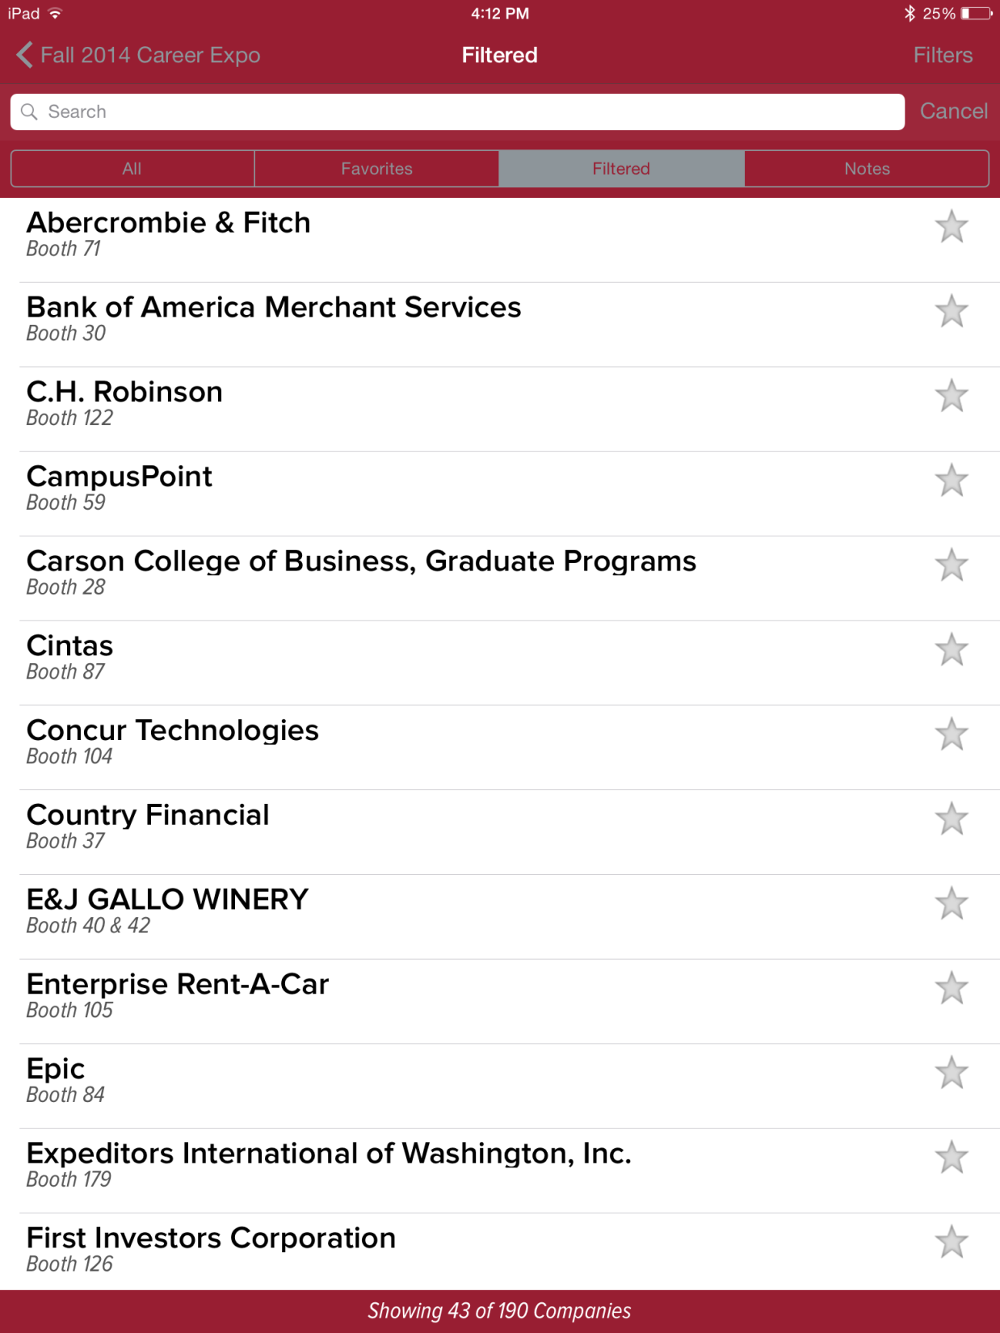
Knowledge of Self and Employer

Slide 27
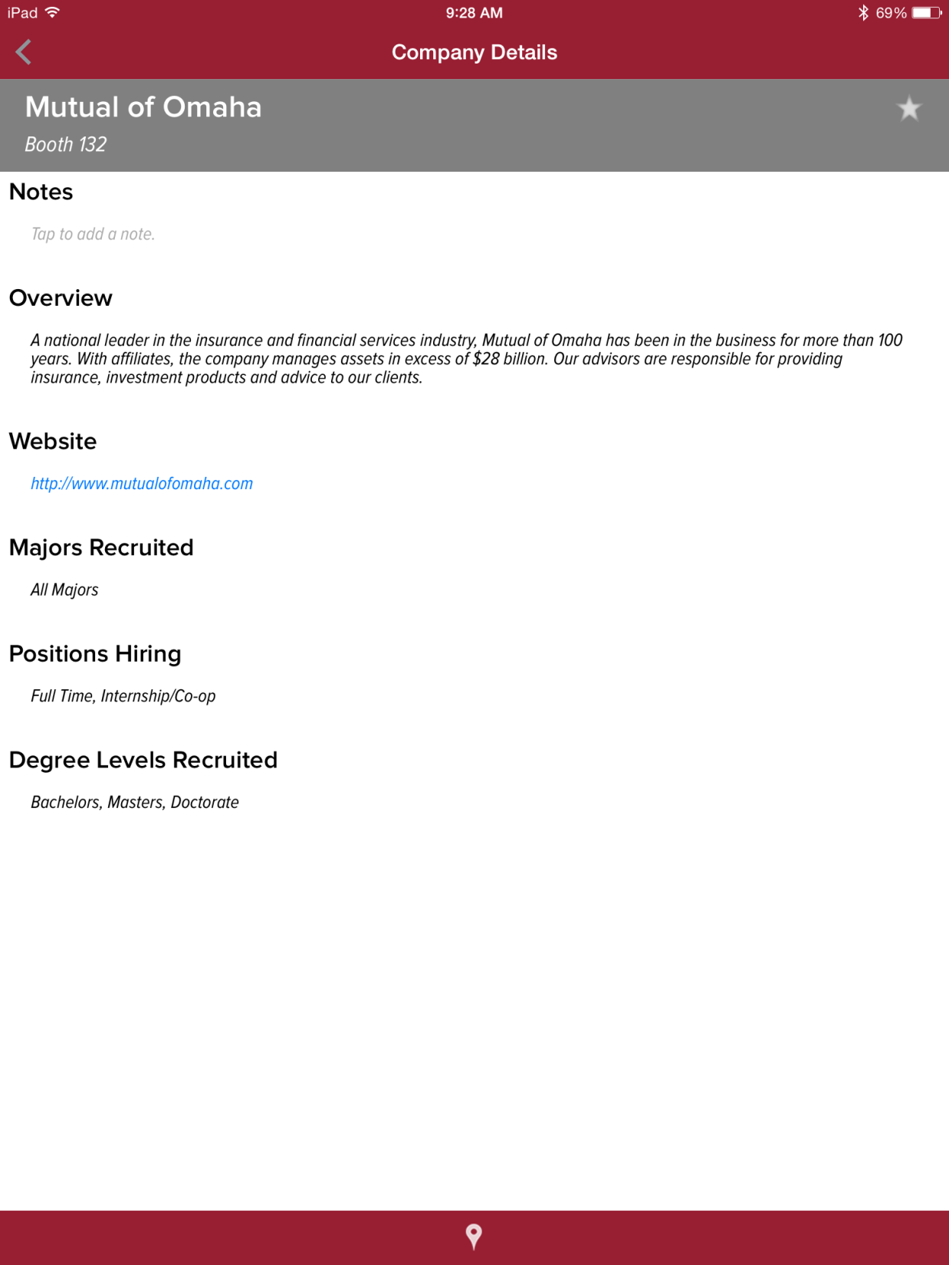
Knowledge of Self and Employer

Slide 28
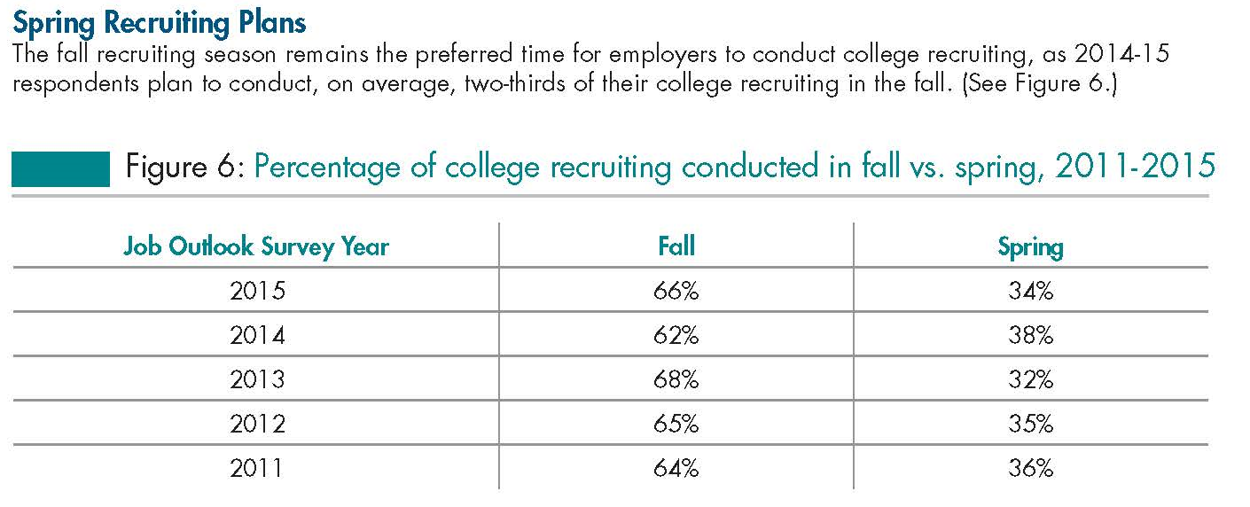
Planning Ahead
Knowledge of Self and Employer
Students who do not have a plan in place by fall of their senior year could miss out on a significant percentage of the recruitment efforts made.
Source: 2015 Job Outlook, National Association of Colleges and Employers
Notes:
Student often struggle with simple questions like when should I bother to start looking? I can’t apply now for a job in May can I? The answer for many employers is yes. Regardless, the efforts put in sooner rather than latter will prove useful to them as they gain an understanding of the processes and expertise of the practices and learn to manage their time in order to complete them side by side with their academics.

Slide 29
Career Development Themes
Your Workshop Objectives
Career worries & desires
Good pay
Foundation for successful internship search
Clearer goals
Is it competitive?
Will my major help me?
Polished resume
LinkedIn/networking strategy
Career Development
Interview preparation
Establishing meaning
Acknowledging challenges
Normalizing the process
Creating a plan
How can I get credentials?
Will I enjoy my job?
Notes:
In the two years that a student may spend discovering options for majors & exploring through coursework and student organizations
As students begin to narrow down possibilities, the Informational Interview is a key tool for students to implement, assisting them in the finer details of what a job or career may entail

Slide 30
Online Resources
Knowledge of Self and Employer
Forbes top internship websites:
www.linkedin.com
www.glassdoor.com
www.google.com
University specific job & internship postings & alumni networks:
www.couglink.org ASCC Job/Internship Postings
www.cbn.wsu.edu Alumni Center Cougar Business Network
www.internships.com
Source: Adams, Susan (2015) http://www.forbes.com/sites/susanadams/2015/01/30/the-10-best-websites-for-finding-an-internship/
Notes:
Student often struggle with simple questions like when should I bother to start looking? I can’t apply now for a job in may can I? The answer for many employers is yes. Regardless, the efforts put in sooner rather than latter will prove useful to them as they gain an understanding of the processes an expertise of the practices and learn to manage their time in order to complete them side by side with their academics.

Slide 31
CougLink
What is a Resume? And Why?
Online location connecting WSU Students to 11,000+ Coug Employers (www.couglink.org)
Every student has an account, students populate it with their own data
Inside CougLink
Academic and Personal Profiles
Upload documents
CougLink Job and Internship Board
On Campus Interviewing
Employer Directory
GoinGlobal.com
Notes:
Show them how to access and fill out academic and personal profiles. Show how to upload resumes. Employers request resume uploads and sometimes pdf resume books. Show job and internship board, click on one opportunity and show them how to apply and employer contact information. On Campus Interviewing. Also demonstrate employer directory and goinglobal.com.

Slide 32
One-on-one Assistance
Types of Resumes
Visit during drop-In hours, 2-4pm, Monday-Friday, Lighty 180
Trained Career Professional to offer you advice and suggestions
Resume and Cover Letter help
Individual Appointments for Career Counseling and Internship Search
We’re here to assist you in exploring jobs and internships and developing your professional toolbox….
Visit www.ascc.wsu.edu or call 509-335-6000 for appointment scheduling

Slide 33
Career Counseling & Testing
Types of Resumes
Our career development counselors view career decision making as an on-going “life-planning” process, rather than a one-time choice.
Through one-on-one 50 minute sessions, career counseling may help you to evaluate and improve your self-understanding, knowledge of the world of work, and decision making skills.
Identify and plan for your career dreams, find ways to overcome career barriers, and become “unstuck” are top reasons to visit with a career counselor.
In addition, career assessments can help clarify your values, interests, and skills, while providing important information to enhance personal growth and self-understanding.
Schedule your appointment online
at www.ascc.wsu.edu or call
509-335-6000

Slide 34
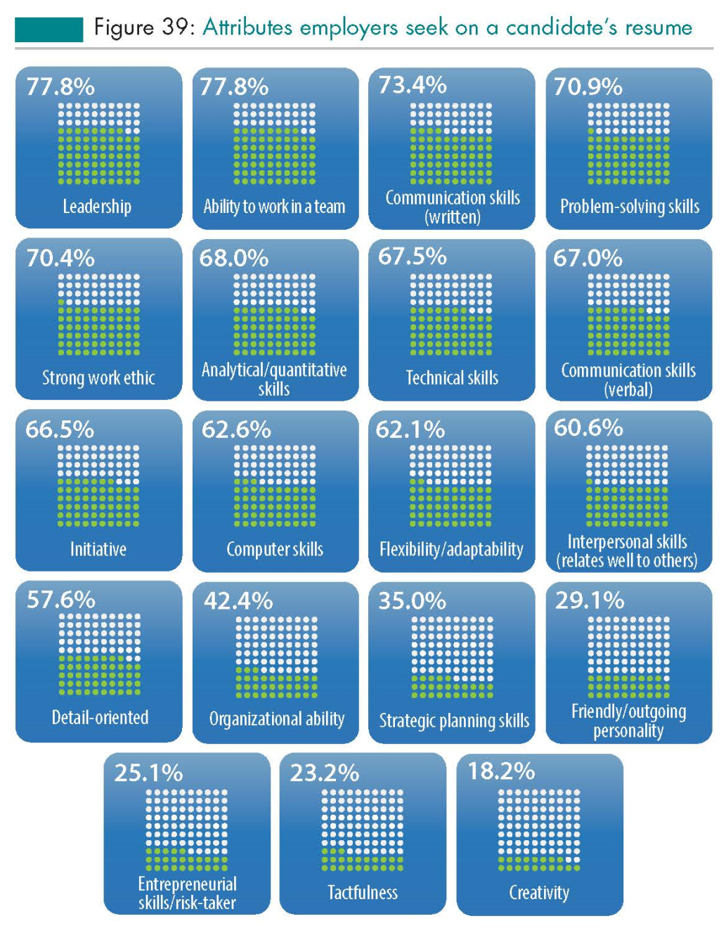
What do employers desire in candidates?
Types of Resumes

Slide 35
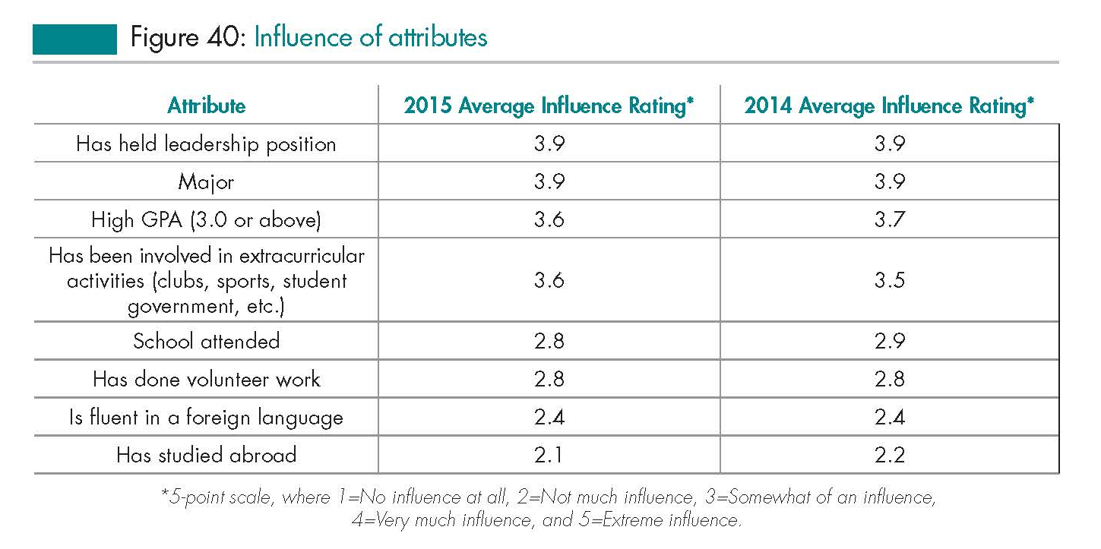
What do employers desire in candidates? Cont.
Types of Resumes
Source: 2015 Job Outlook, National Association of Colleges and Employers

Slide 36
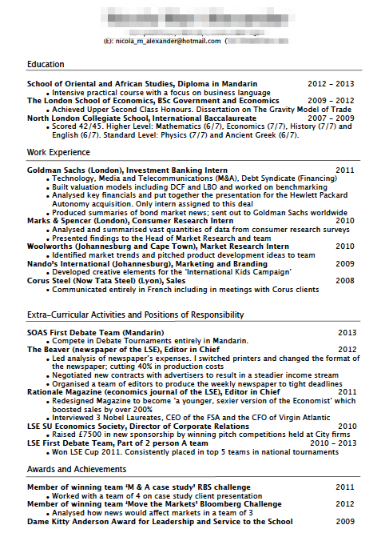
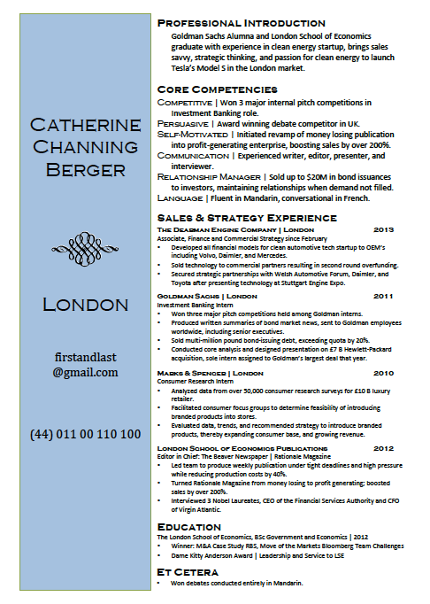
the ASCC is offering…The Resume Coloring Book
Next Steps for your Resume
The Resume Coloring Book
New on-line tool can be accessed through our ASCC web site and CougLink!
Are you serious? A coloring book?

Slide 37
Crafting your Resume- Content
Yes, The Resume Coloring Book
The Resume Coloring Book is a six step, color coded
methodology for resume writing, specifically
developed for students and grads, that:
Teaches students how to write a resume with a 65% higher chance of being read
Teaches students to translate volunteer, internship, leadership, classroom, and other paid and unpaid experiences into skills & competencies employers value.
Teaches the student how to research what the employer is looking for, so that
they can customize the resume for employer attraction.
Builds the student’s confidence as he or she approaches the job search and
interview experience.
Eliminates the confusion and questions that prevent students from
writing strong resumes that get interviews.

